Slide 1


PETPALS
NETWORK
Mentor : Mrs.Vinothini M, AP/IT
Narmatha S (95072215036) Priyadharshini P (95072215041)
Udhayaprabha S (95072215054)

Slide 2


PROBLEM STATEMENT
Users face difficulty managing pet adoption, healthcare, and product purchases across multiple disconnected platforms, leading to inefficiency and poor user experience.
Existing platforms often fail to provide updated pet listings, personalized healthcare suggestions, or product recommendations tailored to individual pet needs.
There is a lack of online platforms offering disease diagnosis modules, streamlined veterinary appointment booking, and access to comprehensive pet healthcare services.
Many systems suffer from poor inventory control, limited service management options, and scalability problems, resulting in stockouts, appointment delays, and user dissatisfaction.

Slide 3
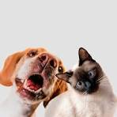
ABSTRACT
PetPals Network is a full-stack web application that seamlessly integrates pet adoption, healthcare services, and pet product commerce into a single, intuitive platform. Developed using React.js for the frontend and MySQL for the backend, the system ensures dynamic user interactions and reliable data management. Users can explore pets for adoption, purchase essential supplies, diagnose pet health conditions through a symptom-based module, and schedule veterinary consultations within the platform. It also offers access to specialized pet services, including grooming, training programs, health checkups, and behavioral therapy. With real-time inventory updates, personalized recommendations, structured checkout processes, and a responsive design, PetPals Network delivers an efficient and engaging user experience. Built with scalability, security, and future growth in mind, the platform aims to revolutionize the pet care ecosystem by enhancing accessibility, efficiency, and service quality for pet owners, shelters, and veterinarians.

Slide 4
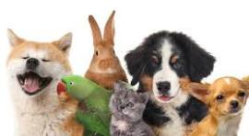
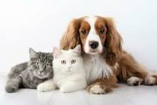
INTRODUCTION
PetPals Network is a full-stack web application integrating pet adoption, healthcare management, and pet product commerce into a single seamless platform.
The frontend is built using React.js for a highly interactive, responsive, and user-friendly experience across devices.
MySQL is used for backend operations, ensuring secure, efficient, and scalable management of pet, product, healthcare, and user data.
The platform enables pet adoption exploration, disease diagnosis assistance, veterinary appointment scheduling, and online purchasing of pet supplies.

Slide 5

OBJECTIVES
To build a comprehensive digital platform that integrates pet adoption services, healthcare management, and pet product commerce within a single ecosystem.
To deliver a seamless user experience through an intuitive, responsive, and dynamic frontend developed using React.js technology.
To ensure secure and efficient data management by utilizing MySQL for handling user profiles, pet listings, service bookings, inventory, and order records.
To implement intelligent recommendation systems for personalized product suggestions, grooming/training services, and pet disease diagnosis using AI and machine learning algorithms.
To enhance connectivity between users, service providers, and veterinarians by offering real-time service booking, product purchasing, and consultation scheduling capabilities.

Slide 6
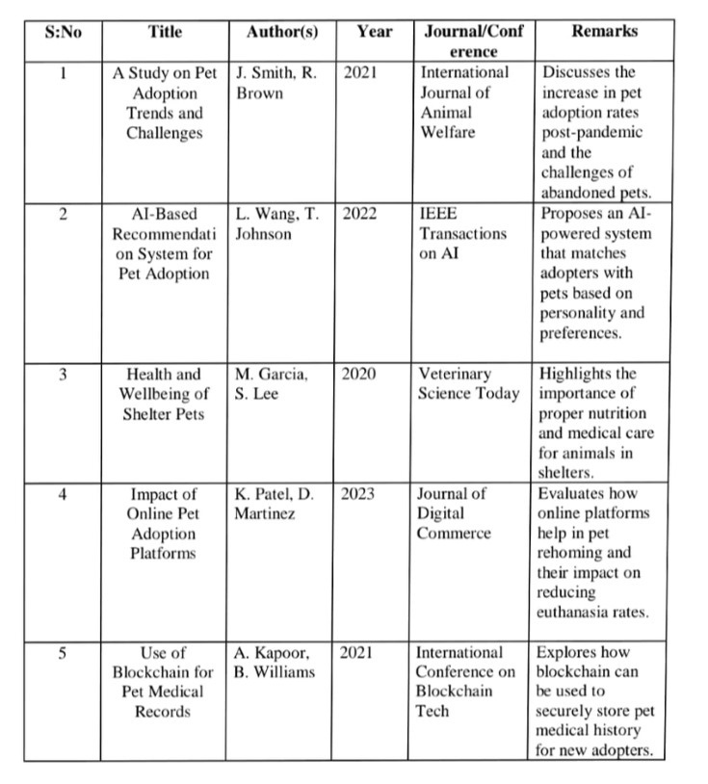
LITERATURE SURVEY

Slide 7
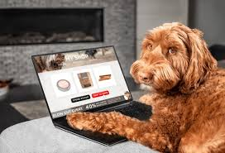
EXISTING SYSTEM
Fragmented Services: Current platforms separately handle pet adoption, healthcare consultations, and pet product commerce without offering a unified solution.
Limited Personalization: Most existing systems lack machine learning-driven personalized recommendations for pet healthcare, grooming, training, or product suggestions.
Inefficient User Experience: Users must navigate multiple websites or apps for adopting pets, buying products, and booking veterinary services, causing inconvenience and confusion.
Lack of Integrated Healthcare Support: Existing pet adoption platforms rarely offer integrated health diagnosis tools or real-time veterinary consultation scheduling.

Slide 8
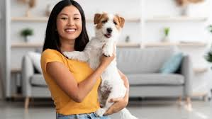
PROPOSED SYSTEM
PetPals Network brings together pet adoption, healthcare services, veterinary consultations, and pet product commerce into a single web-based platform, ensuring a complete solution for pet owners and adopters.
The system is divided into clearly defined modules Pet Adoption, Pet Healthcare Management, Veterinary Appointment Scheduling, Pet Product Shopping, and Service Registrations.
Pet profiles, service availability, and product inventories are updated in real-time, ensuring users always access the latest information without delays or inconsistencies.
Designed with React.js, the platform offers a highly responsive and intuitive user interface, making browsing, booking services, and shopping for pet needs seamless across all devices.
Using MySQL, the backend securely handles large volumes of user data, pet details, appointments, and product orders, ensuring robust performance and scalability as the platform grows.

Slide 9
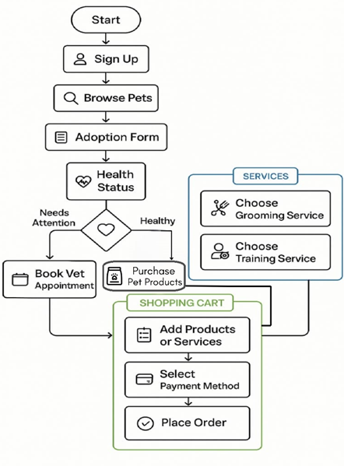
ARCHITECTURE DIAGRAM

Slide 10
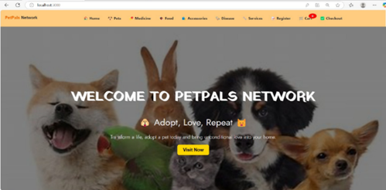
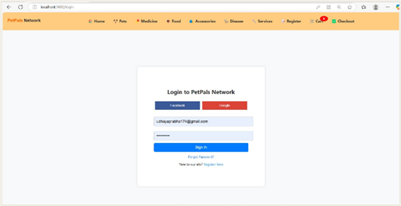
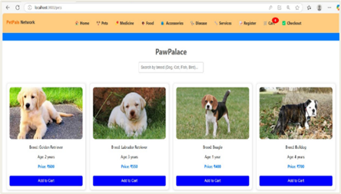
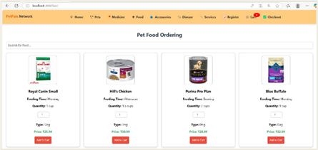
OUTPUT

Slide 11
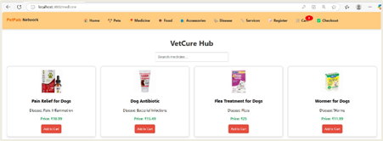
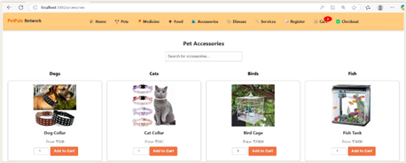
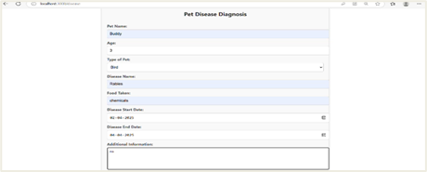
OUTPUT

Slide 12
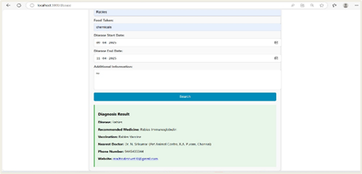
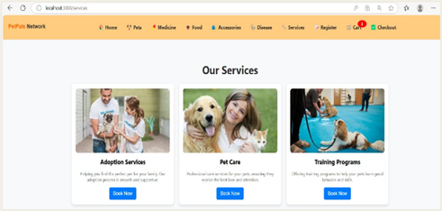
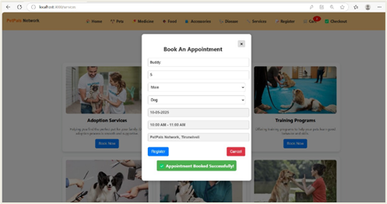
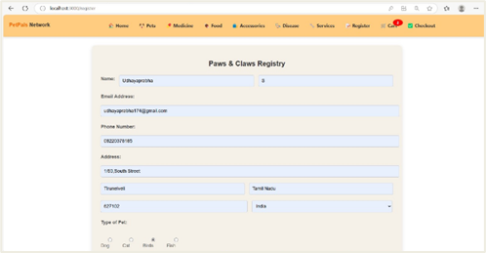
OUTPUT

Slide 13
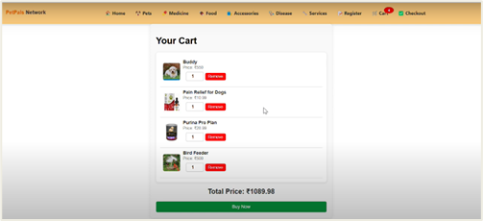
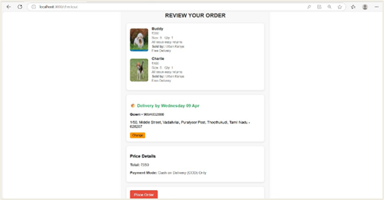
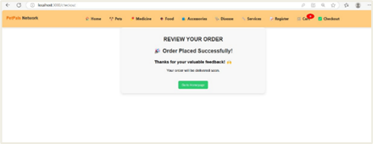
OUTPUT

Slide 14

React.js (Frontend Development)
React.js is used to build a fast, dynamic, and responsive user interface. It ensures a smooth user experience while browsing pet listings, booking services, and managing carts and orders.
MySQL (Database Management)
MySQL serves as the robust backend database to securely store and manage user profiles, pet adoption records, product inventories, healthcare data, and transaction histories.
Node.js (Server-Side Development)
Node.js, along with Express.js, is used to build the backend server, handling all API requests, authentication processes, and communication between the frontend and database.
Firebase (Authentication & Cloud Functions)
Firebase provides secure user authentication for login and registration. It can also be optionally used for cloud storage of pet images and real-time database service
Deployment (Firebase Hosting)
The PetPals Network platform is deployed through Firebase Hosting, offering high performance, SSL security, and real-time scalability. This ensures seamless user access, quick load times, and a reliable experience across all devices.
GitHub (Version Control & Collaboration)
GitHub is utilized for version control, enabling efficient collaboration, tracking changes, and maintaining a structured and updated codebase throughout the development cycle.
MODULES AND ITS
DESCRIPTION

Slide 15
RESULT
The development of the PetPals Network successfully achieved its primary objectives of integrating pet adoption, healthcare management, and pet product commerce into a unified platform. Users can easily browse available pets, access healthcare services, purchase pet-related products, and schedule veterinary consultations through an intuitive and responsive interface. The adoption of React.js for the frontend ensured smooth navigation and dynamic user interactions, while MySQL provided a stable and scalable backend to manage all user, pet, and product data efficiently. Secure authentication through Firebase enhanced platform reliability. The deployed system demonstrated strong performance, real-time updates, and a high level of user engagement, effectively bridging the gap between pet seekers, service providers, and veterinarians. Overall, the platform offers a seamless, efficient, and comprehensive digital ecosystem for pet enthusiasts.

Slide 16

[1]. A. Joshi, R. Kapadia,
"Design and Development of an Online Pet Portal Using React.js and Firebase",
International Journal of Emerging Technologies in Engineering Research, 2022.
[2]. A. N. Prathamesh, R. K. Radhika,
"Smart Pet Healthcare Monitoring System using IoT",
IEEE International Conference on Smart Technologies and Management, 2020.
[3]. Ankit Jain, Neha Mehta,
"Development of an Online Pet Store Using MERN Stack",
International Journal of Scientific Research in Computer Science, 2021.
[4]. D. Menon, V. Suresh,
"Blockchain-Enabled Secure Pet Adoption Registry",
IEEE Access, 2023.
[5]. Hina Gull, Asma A. Alharbi, Lama A. Alahmari, Roaa S. Alghamdi, Salma S. Nasser, Samar S. Alqahtani,
"Vet the Pet: Design of an Intelligent Health Prediction System and Health Care Application for Furry Friends in Saudi Arabia",
IEEE, 2021.
REFERENCES

Slide 17
JOURNAL
Journal Name : International Journal of Research in Engineering and Management (IJSREM)
Journal Number : ISSN 2582-3930
Volume : 09 Issue : 04
PUBLICATION
DETAILS

Slide 18
THANK YOU
https://pet-adoption-d9977.web.app/

